Slide 1
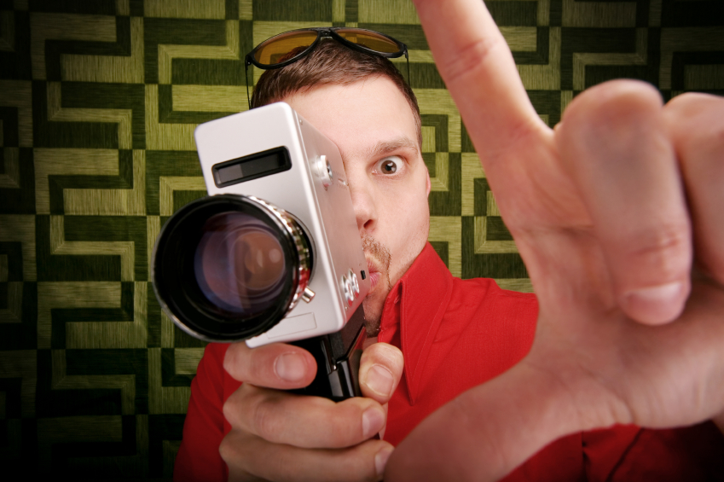
Creating a Movie

Slide 2
Video Devices
Video camera
  Flip Cameras
  Still cameras than can take video
Smart Phones
iTouch
Tablets such as the iPad and Android tablets
Notes:
There are many varieties of video cameras. Kodak and the Flip cameras are some we have that you can check out. Many still cameras also can record short videos. Most newer models have this capability. Just about all Smart Phones can record video. You should have directions that came with the phone to retrieve the video. The newer iTouches can also record video. The 2nd generation iPad and other tablets can record video. To video from an iTouch or iPad you will need to set up an e-mail address and e-mail it to someone.

Slide 3
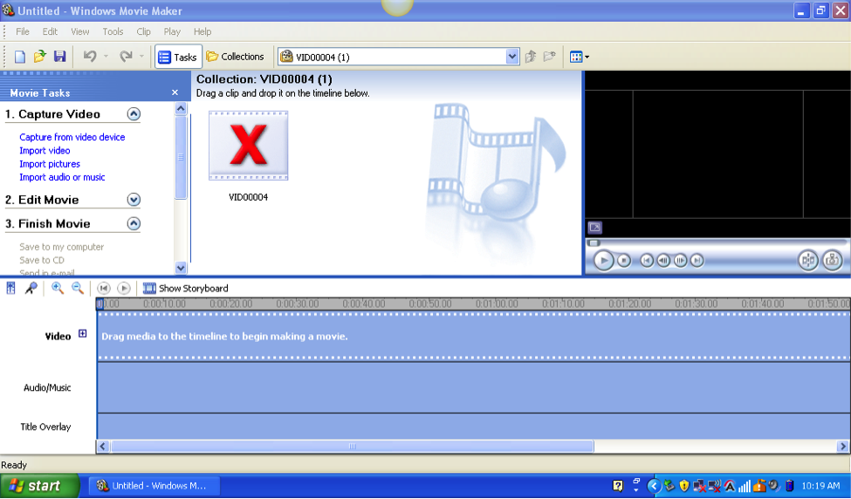
Movie Maker Navigation
Preview Area
Menus to reach each function. Click on Arrows beside each big title to seem more choices.
Collection area. This is where media you import will show up.
Storyboard
Notes:
Menus- A link to each menu is located on the left-hand side of the screen.
Collections- Each time you import a collection is created. They’re located in the center of the top section. To view other collections click on the drop down menu above this area.
Effects and Transitions will show up in the middle section for selection.
The default view of the storyboard will show each clip and the titles or transitions that have been added. Click Show Storyboard to view the timeline of how everything fits together or overlaps.

Slide 4
Inserting Video or Pictures
Select how you wish to import video or pictures.
Notes:
Some cameras video files will not work with Movie Maker. These directions are for those that do work with Movie Maker. However the directions can be used for other video software as it will be very similar. If you device can import directly into Movie Maker click on the first choice. Then follow the onscreen directions. It will be slightly different depending on the device. The second choice is for cameras that you need to insert the video first and then import it into Movie Maker. Insert Video and Pictures works basically the same way.

Slide 5
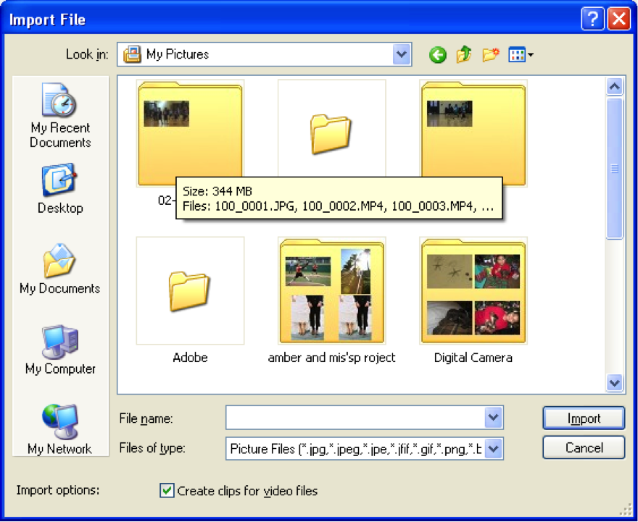
Inserting Pictures and Video
When inserting pictures or videos already saved on the computer you will see a screen like this. You will need to navigate to the right location to retrieve the files.
Notes:
If you will be using still pictures and adding effects such as zooming, adding rain, etc. select the 3rd option and then go to the folder where the pictures are found. If you’re using video from another camera or phone you can select Video and also locate the folder where you save it. Be sure to pay attention which folder the pictures or video are being saved.
Click on My Computer
Select your Flash drive
Locate folder you saved your pictures or video in and click once to select.
Click Open
Click on the picture or video you want to import and click Open.

Slide 6
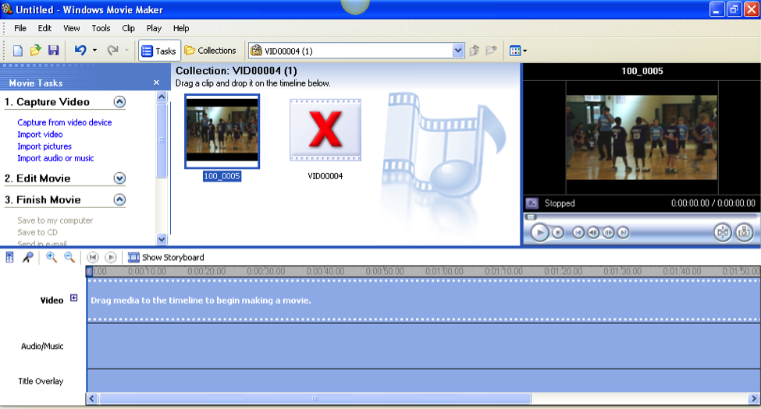
Completed Import
Notes:
This is what your Movie Maker screen will look like after the import is complete. Remember that even though it shows the pictures and video it really hasn’t moved the video. So you should save Movi e Maker to the same flash drive that you have the video.

Slide 7
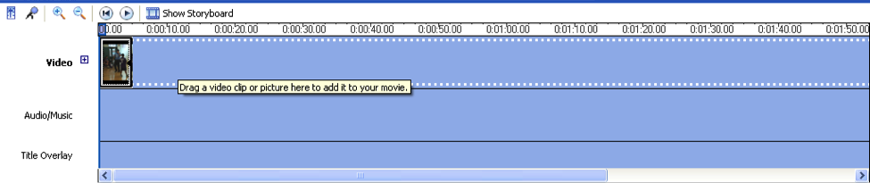
Storyboard with Media
Click Show Storyboard to see timeline demonstrated here.
Notes:
This is what the storyboard looks like once media has been dragged into the timeline. This is the bottom part of the screen. If you have titles that don’t like up correctly or accidently import a picture or video twice it can be deleted or readjusted here.
Click what you want to remove once and then click Delete or Backspace.
To move an object click and drag to where you want to move it.

Slide 8
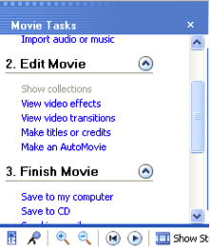
Edit Movie Menu
Use this menu to add video effects, transitions and credits.
Click on the menu item and then select the effect in the middle of the screen.
Drag effects to Storyboard and Apply Titles.
Notes:
Click the arrow to expand the edit tools.
Video Effects- ways to change the look of the video. For example is you want the video to look old select Sepia tone. You can add rain to a video here too.
Video Transitions- this is similar to transitions in Power Point. This is how one video segments moves to another.
Titles or Credits- The title is at the beginning or during the video and credits are at the end.

Slide 9
Using Audio in Your Movie
Use Audio from a free music website
Record your own music in Audacity
Record voiceovers directly into Movie Maker

Slide 10
Music Websites
www.freeplaymusic.com
www.incompetech.com/m/c/royalty-free
www.freesfx.co.uk
Make sure to check the usage of each site before downloading audio files.
Notes:
There are many sites on the internet that provide music downloads. You need to always check for copyright status to ensure you can freely use the music. These sites are safe ones to use. If you want to use a popular song not available free you may only use 30 seconds of the song legally.

Slide 11
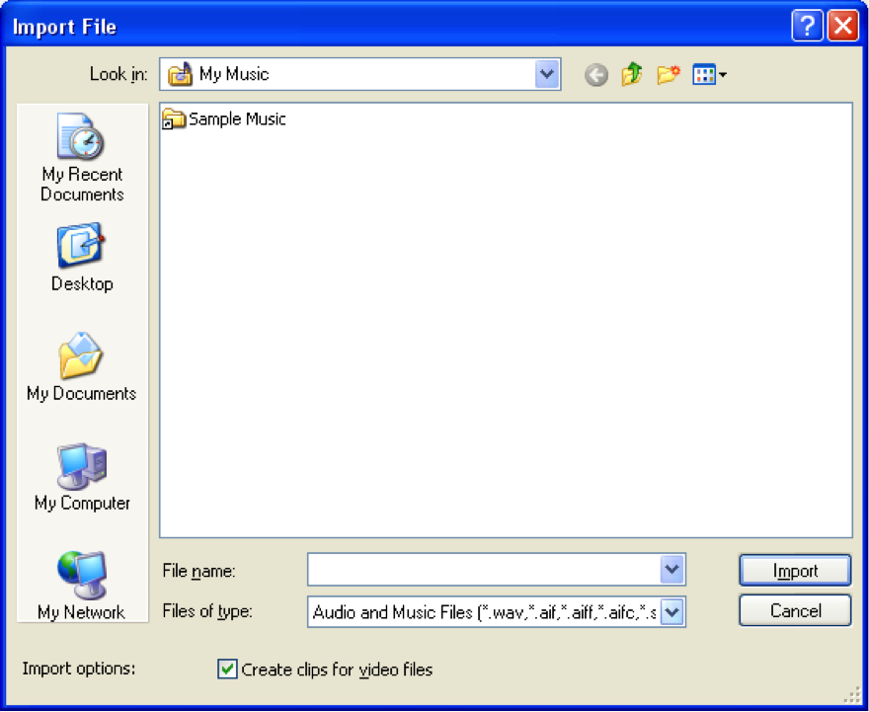
Importing Audio
To begin importing Audio use the Import Audio link in the Capture Video section of the menus.
This screen will appear.
Locate where you have saved audio files.
Notes:
Once you have downloaded music files you will need to import them into a collection in Movie Maker. Make sure you pay close attention as to where you have saved the files. This will help you to be able to import them.

Slide 12
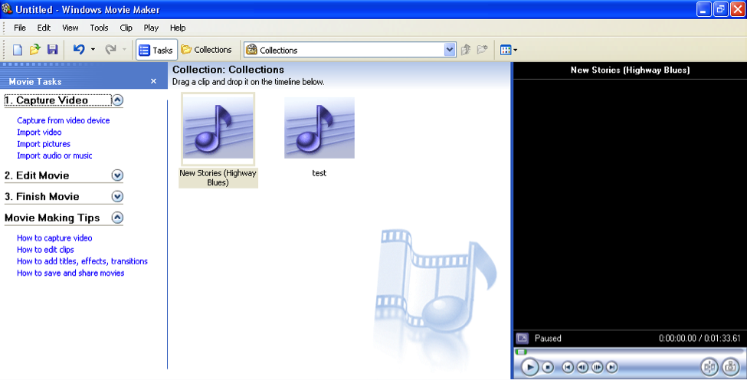
Completed Audio File Import
Notes:
Once you have selected the audio files you wish to import this is what it will look like in Movie Maker.

Slide 13
Using Your Own Audio Music Files
Audacity can be used to make a recording of your own music to be used with your commercial.
For more information on steps in using Audacity go
http://ms-wagoners-corner.weebly.com/previous-tips.html.
Voiceovers can be recorded directly into Movie Maker to explain something you’re showing
Notes:
The next few slides will demonstrate how to make your own recordings.

Slide 14
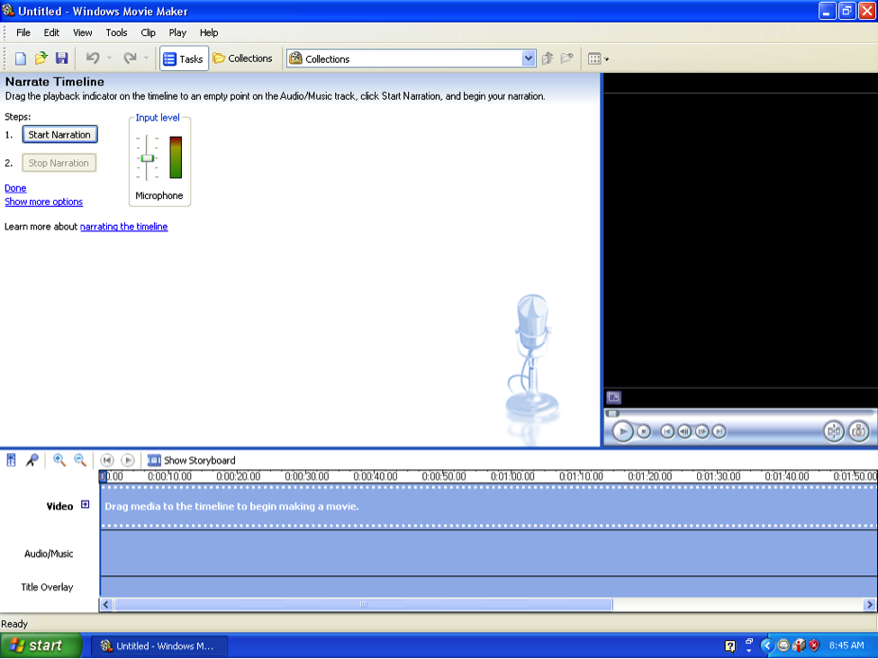
Recording Narration
Click microphone to start recording
Notes:
Click microphone and the program will put you automatically into the timeline view.
Click the Start Narration button and then click Stop Narration when you’re finished.
Then you will be prompted to save the narration. Give it a file that you will be able to recognize.

Slide 15
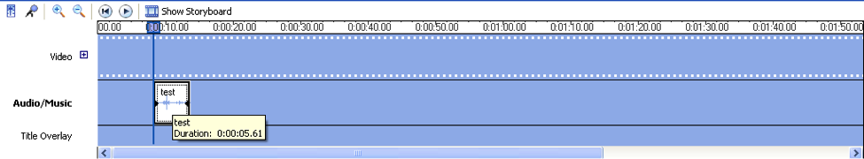
Adding Audio Files to Movie
Notes:
Once the audio narration has been saved it will now appear in the collection for audio files. Click and drag the audio file you wish to use into the timeline at the bottom of the screen.

Slide 16
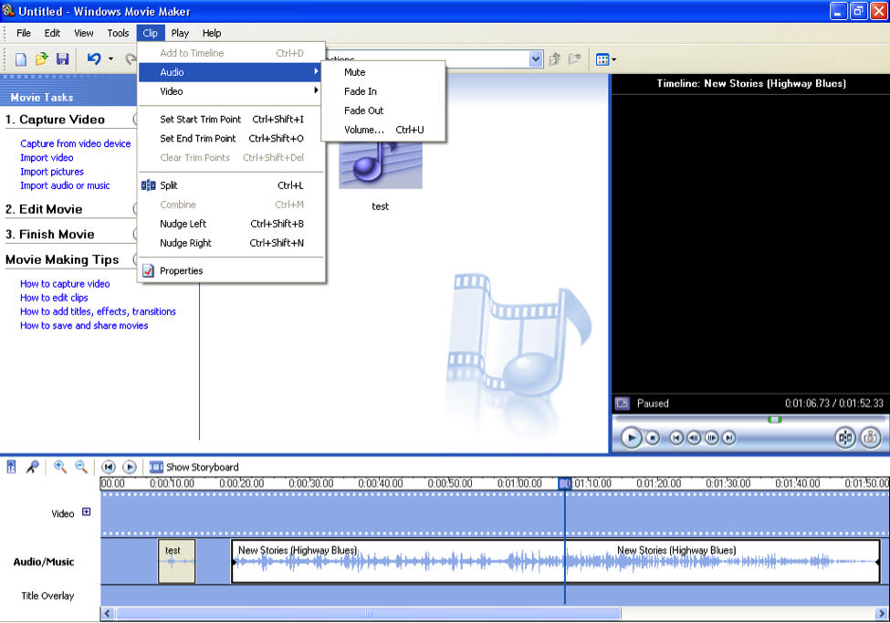
Edit Audio
Notes:
There are several ways to edit your audio.
Split a audio file or song.
Shorten or lengthen file.
Copy and paste
Fade in or out
Use the Clip menu to split a clip in half by placing the cursor where you need to split the clip and select Split.
Make a song fade in or out by using the Audio part of the Clip menu. (Shown above)
To make a song play again simple click on it once to select, then use Ctl+C to copy and Ctl+V to paste.

Slide 17
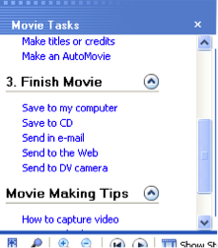
Finish Movie Menu
The video can be saved several ways.
You will want to save it to the computer.
Notes:
Saving to computer
Click Save to my computer.

Slide 18
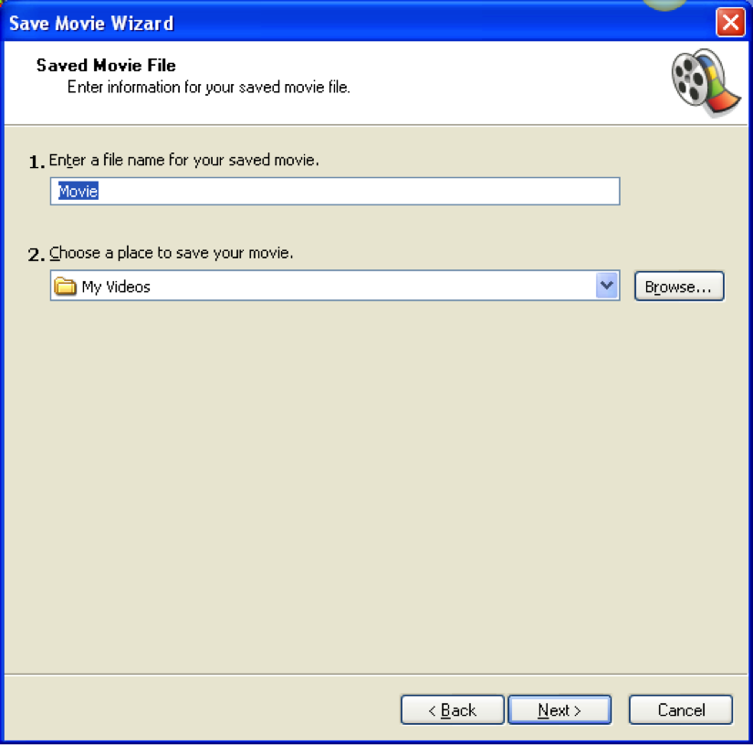
Finishing Movie
Once you click on “Save to Computer” a series of screens will appear.
Follow the onscreen directions.
Notes:
Here is where you will want to click on Browse and find your flash drive.
Select your flash drive.
Click My Computer
Your flash drive will show up as Removable Disk. Click once to select
Click Open

Slide 19
Before Bringing Video To School
Make sure you can find your video on your flash drive.
Play video to make sure it looks like you planned.
Verify that you have finished your movie. You will be working with a Movie Maker project file until you do the finish step.
Notes:
Pictures and videos you have imported will be saved and transported with video once you do the Finish Movie steps.

Slide 20
Contact Information
If you’re having trouble and need help feel free to contact Ms. Wagoner at rwagoner@waynesboro.k12.va.us.

